Slide 1
Pest control in the office
presented by
The United Citizen Federation
Notes:
Welcome, everyone, to today’s webinar. I’m your host, Aston, and I’ll be going over a few key points over how you can help keep pests out of your office space.

Slide 2
Goals!
1) Learn about different types of pests
2) Learn about the dangers of pests
3) Learn about the benefits of a pest-free workspace
4) Learn how to be proactive in your pest control
Notes:
So after this webinar, our goal is for everyone to be a little more familiarized with some different types of office pests and what we can do to minimize them. If everyone chips in and does their part, then we’ll be able to create a clean and safe environment for everyone. Today, we’re going to go over a few different types of pests, why they’re dangerous, why it’s important to minimize pests in the places where we work, and a few strategies that we can all do to make sure that our spaces stay pest-free.
(An insect-free environment enhances the comfort and productivity of employees. Pests can be distracting and create an unpleasant atmosphere, affecting focus and morale.)

Slide 3
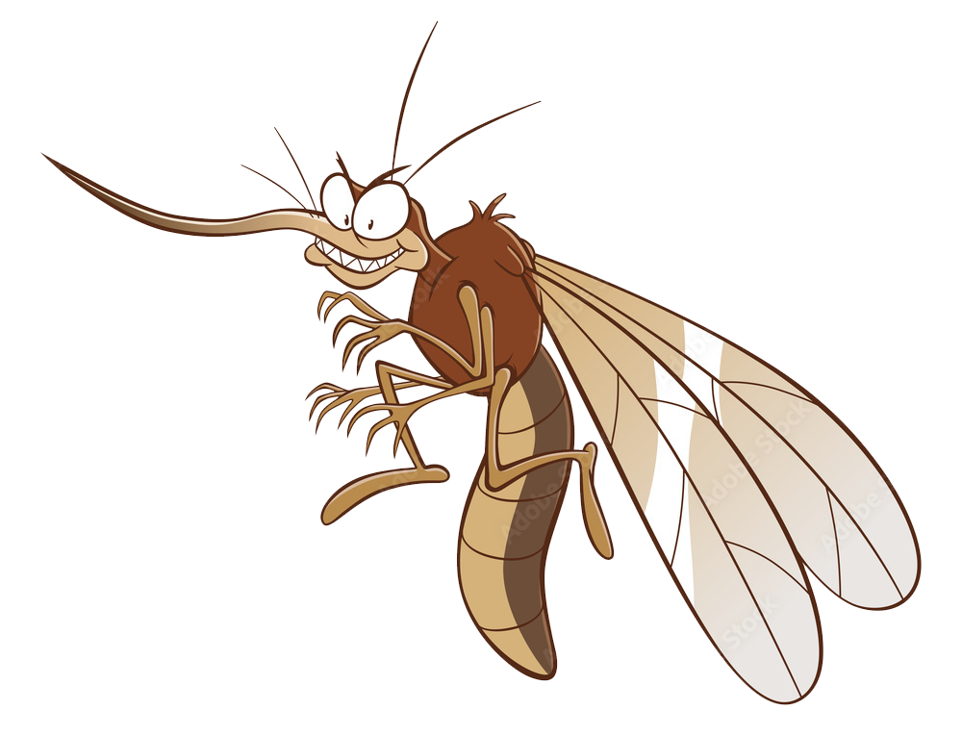
pests are bad
Allergens
Disease
Health Risks
Notes:
Everyone knows that pests like mice, roaches, and ants are bad, but what exactly about them is so bad? While yes, every pest has its place in the food chain, many office pests interfere with our daily lives. They often carry diseases, trigger allergies, and pose other health risks to humans, especially in those of us with weakened or compromised immune systems.
(Pests can carry diseases and allergens, posing health risks to occupants. Effective pest control helps maintain a clean and safe environment, safeguarding the well-being of everyone in the office.)

Slide 4
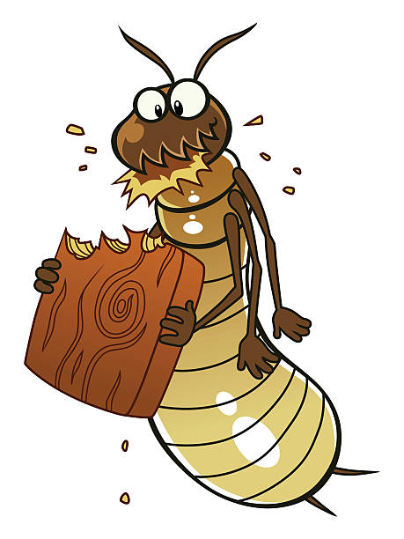
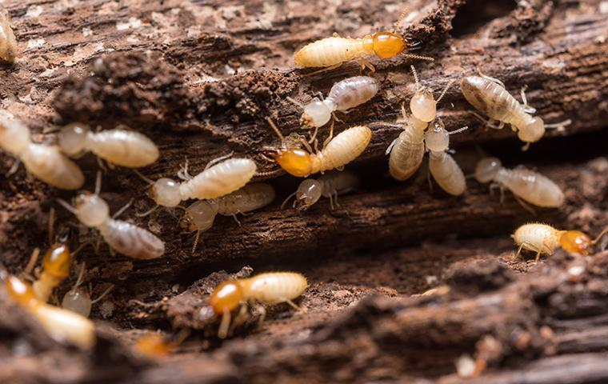
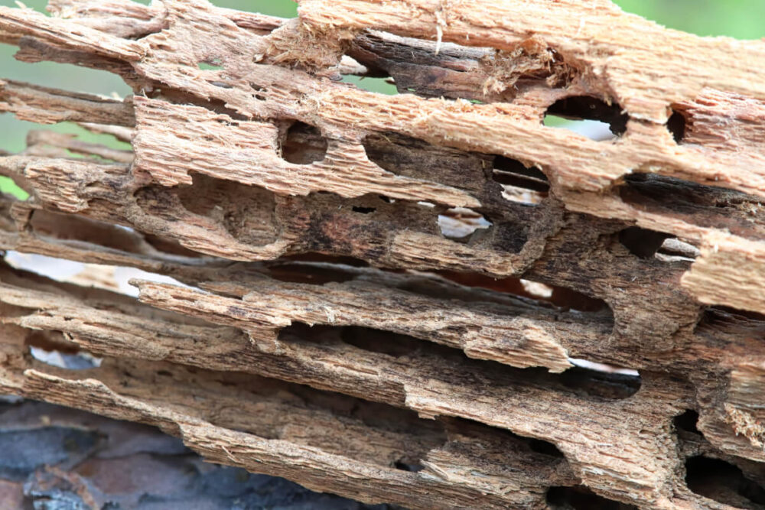
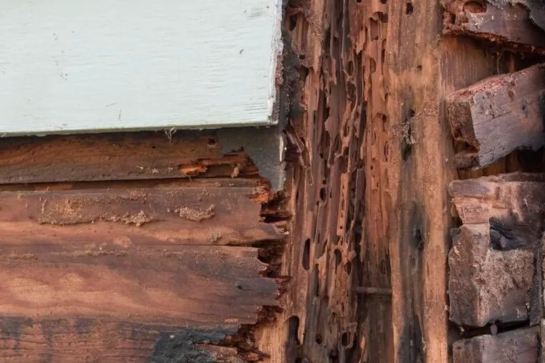
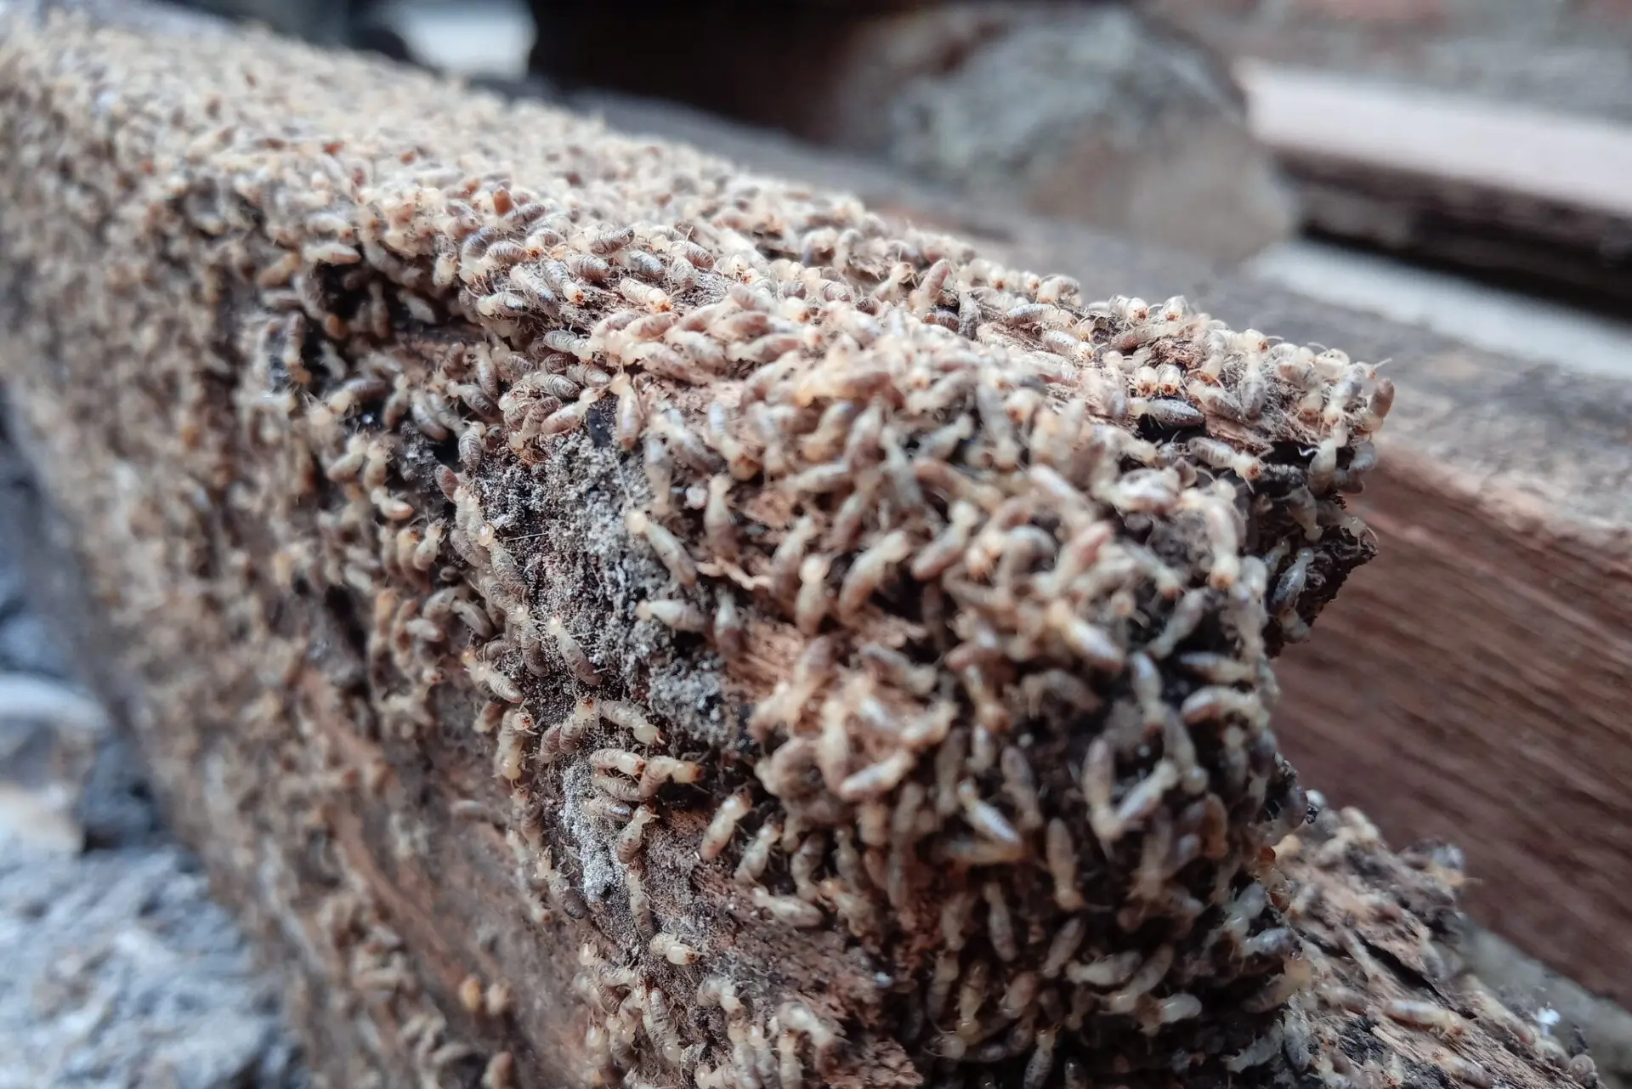
termites
According to the United States Department of Agriculture (USDA), U.S. residents spend at least $1 billion on Formosan termite control and repairs each year. Some experts estimate the number is closer to $2 billion.
Notes:
I want to specifically point out one of the more notable office pests: Terry the Termite. Terry loves eating wood, which is a problem because so many of the things we use at the workplace are made of wood and wood products! Every year, termites cause billions of dollars in damages in the United States. It’s estimated that a homeowner who suffers from termites will spend an average of 3,000 dollars in repair costs, making Terry here one of the more destructive pests in the office.
(Pests like termites can cause considerable damage to buildings and furniture. Regular pest control prevents structural damage, preserving the integrity of the office space and minimizing repair costs.)

Slide 5
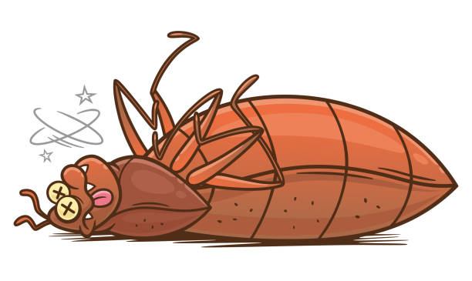
Be insect free!
The only good bug is a dead bug!
Notes:
Studies have shown that insect and pest free environments enhance comfort and productivity. Imagine having flies buzzing around your head while you’re having a meeting, or mice in the break room when you’re trying to eat lunch. Pests can be distracting and create an unpleasant atmosphere, affecting focus and morale.
(An insect-free environment enhances the comfort and productivity of employees. Pests can be distracting and create an unpleasant atmosphere, affecting focus and morale.)

Slide 6
regulations
Property Maintenance Regulations – Overland Park, KS
Notes:
Knowing this, many cities and states have put regulations into place regarding pests, especially in commercial spaces. Following these guidelines will not only help lower the chances of pests affecting your work life, but doing so can potentially avoid legal issues as well. After this webinar, I’ll be emailing all of you this presentation, which has links to some guidelines specific to your region.
(Many regions have regulations regarding pest control, especially in commercial spaces. Adhering to these regulations ensures compliance and avoids potential legal issues.)

Slide 7
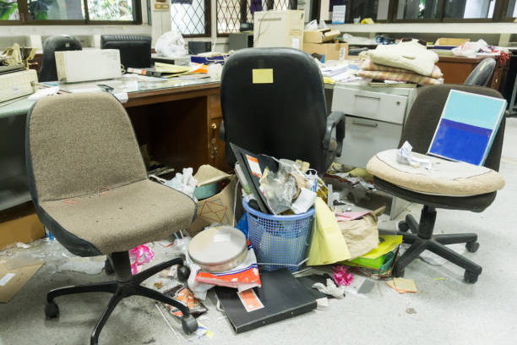
Make a good impression!
VS
Notes:
Ask yourself, how would you feel if you walked into a place of business and saw that it was infested with ants and roaches? I’m sure most of us would agree that such a place would be at least a little gross. Having a pest-free environment is essential to maintaining a positive reputation from clients, partners, and other employees.
(A pest-free environment contributes to a positive reputation. Clients, partners, and employees may view pest-infested spaces negatively, impacting the overall image of the business.)

Slide 8
Have a plan
Monday
Tuesday
Wednesday
Thursday
Friday
Notes:
To that end, it’s important to be diligent about pest control measures. Drawing out a weekly or monthly pest control plan is one of the ways that we can be proactive about keeping our spaces safe and presentable. Remember, preventing pests from invading our spaces is always easier and more cost effective than trying to get them out.
(Regular pest control measures, including proactive steps, help prevent infestations before they become severe. This proactive approach is more cost-effective and less disruptive than dealing with established infestations.)

Slide 9
Keep it clean
Notes:
One of the ways we can be proactive about pest prevention is to maintain cleanliness. Focus on communal areas, especially places that involve food such as kitchens, breakrooms, and dining spaces. If you’re one to snack at your desk, make sure to clean up after yourself as well.
(Maintain Cleanliness. Focus on communal areas like kitchens, break rooms, and dining spaces. Pay attention to desks and workstations where food might be consumed. This will have a high impact. Keeping these areas clean directly reduces the attractiveness of the workspace to pests, making it less likely for them to infest.)

Slide 10
Keep them out
Wiring
Doors
Windows
Gaps
Notes:
Another preventative measure we can take is to keep pests from entering our space in the first place. Make sure to check doors and windows for potential entry points. If plumbing or wiring are not properly sealed, pests may gain entry through those small gaps too.
(Seal Entry Points. Check windows, doors, and any gaps in walls. Ensure that utility entry points, like plumbing or wiring, are properly sealed. This will have a moderate to high impact. While sealing entry points is crucial, its effectiveness depends on identifying and closing all potential openings. It complements other measures for comprehensive control.)

Slide 11
The right tools
Natural Fly Traps
Essential Oil Sprays
Herbs
Cedarwood Blocks
Notes:
If proactive, preventative measures aren’t enough, our next line of defense consists of non-toxic repellents or traps. Place traps near areas of high insect activity and repellents near entry points like windows. However, these tools are more effective for specific, targeted problem areas and may not address the root causes of infestations. Make sure to continue your proactive, preventative habits as well to ensure maximum effectiveness.
(Use Non-Toxic Repellents or Traps. Place traps near entry points or areas with high insect activity. Use repellents in strategic locations like around windows or where pests are commonly found. This will have a moderate impact. Effective for specific areas, traps and repellents provide targeted control. However, they may not address the root cause and should be used in conjunction with other measures.)

Slide 12
Talk to the pros
Consult your employee handbook for details on how to request a professional exterminator.
Notes:
Finally, if all else fails or if the infestation gets out of hand, let the professionals handle it. While calling in an exterminator may be costly, they’ll be able to more effectively handle your pest problem, especially if the cause of the infestation is difficult to discern, hard to reach, or too severe. Your organization will have procedures in place, so make sure to bring the issue of pests up to your supervisor or HR representative before it’s too late.
(Consult Professionals. Seek professional services for persistent infestations in hard-to-reach areas or if the issue is widespread. This will have a high impact but will be very expensive. Professionals offer tailored solutions, ensuring effective pest management. This step is crucial when other measures have not provided satisfactory results or for severe infestations.)

Slide 13
Be thorough!
Be proactive and organized about pest control
Stay informed about pest control
Enlist your organization’s professional exterminator
Use multiple pest control strategies in tandem
I’m doing my part!
Notes:
Each of these pest control solutions is most effective when used with each other. If we all pitch in and do our part, we can make sure that our workspace is clean and safe for everyone.
(Each solution plays a vital role, and their effectiveness is interdependent. A combined approach, incorporating all these measures, is the most effective way to tackle an insect problem comprehensively.)

Slide 14
Thank you for doing your part
in our fight against pests
The United Citizen Federation
Notes:
And that ends today’s presentation. As I mentioned before, I’ll be sending up a follow-up email with information about your local pest control laws as well as your organization’s procedures when calling in a professional exterminator. In that email, there will be a short 2 minute survey, and we’d greatly appreciate it if you took some time to help us out and tell us your thoughts about what we’ve covered here today. Thanks again for doing your part, and together we can create a safe place free of pests.

